Slide 1

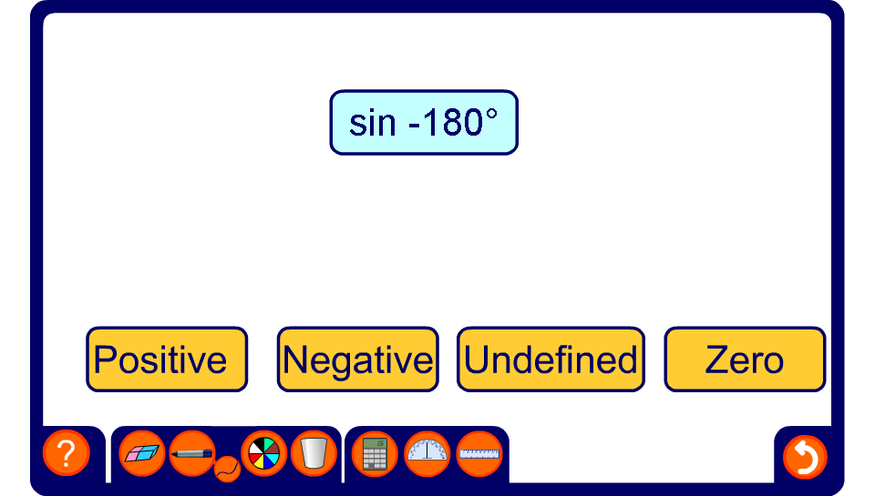


Positive or negative?
Notes:
Start by establishing which quadrant the given angle is in. Ask pupils to use this to decide whether the sin, cos or tan of the given angle will be positive or negative.

